Slide 1
Community Allies in Healing
Men Creating Peace

Slide 2
What is Men Creating Peace (MCP)?
Men Creating Peace (MCP) is a certified Violence Prevention and Education program. We conduct trainings and provide counseling, court-mandated Batterer’s Treatment and Anger Management classes. We have been serving communities in Oakland and throughout Alameda County for 16 years
www.mencreatingpeace.org

Slide 3
Misti Harrelson
Survivor of 10 years of domestic abuse
Impact: extensive hospitalization, loss of one eye, multiple permanent physical injuries and emotional trauma
2020 Graduate with BA in Psychology, Cal State East Bay, Dean's List & Honor Roll
Working towards Masters in Public Administration
Activist, Violence Prevention Advocate, Public Speaker & Life Coach
Employee of Alameda County District Attorney Victim Witness Division and Men Creating Peace

Slide 4
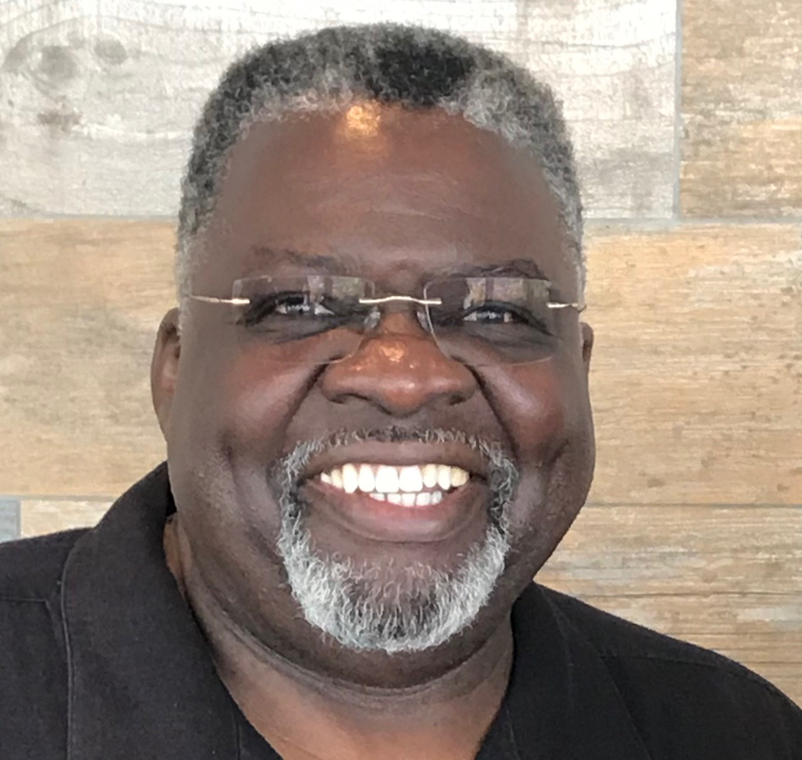
Will Yancy
Ordained Minister 36 yrs
Senior Pastor 25 yrs
22 yrs Executive Director, Triumph Educational Center
21 yrs Certified Batterer Treatment facilitator and Trainer
9 yrs Training Clergy IDVN Alameda County Family Justice Center

Slide 5
Devon Gaster
Former DV offender
26yrs as a Violence Prevention Advocate, Certified Batterer’s Treatment facilitator and trainer
19 yrs working in Bay Area incarcerated settings
16 yrs Founder & Executive Director of Men Creating Peace

Slide 6
Learning Objectives
Increase community awareness
Learn types of Intimate Partner Violence (IPV) and Domestic Violence
Impact to Family, Children & the Community
Red Flags to look for - Victims and Persons who cause harm
How to begin assisting with Safety Planning
Community Resources

Slide 7
Definition of Intimate Partner Violence
Domestic Violence or Intimate Partner Violence is “A pattern of abusive behavior in any relationship that is used by one person to gain or maintain power and control over another person.” It can be physical, sexual, emotional, economic and/or psychological.
National Coalition Against DV

Slide 8
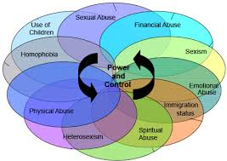
Types of Abusive or Violent Behaviors
Emotional - Manipulation and control
Verbal - Taunting, trivializing, name-calling, threats
Physical - To: Slapping, hitting, choking, kicking
Physical - Around: Breaking things, throwing things, slamming doors
Economic - Holding financial resources, credit fraud, not working
Spiritual - Force partner to abide by certain religious practices & laws
Racial - Name calling, insults about race or ethnic background
Sexual - Cheating, sex without consent, pressuring, unwanted touch
Psychological - Gaslighting, guilt tripping, manipulation

Slide 9
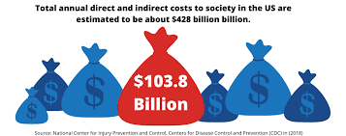
Impacts of Domestic Violence in the US
Economic Impacts • Survivors of IPV lose over 8 million days of work each year (= 32,000 full time jobs)
Reporting Domestic Violence: Only 25% of all physical assaults, 20% of all rapes, and 50% of all stalking perpetrated against females by their partners are reported to the police.
For the larger number of cases that do not get reported, on average, a woman will be assaulted by her partner 35 times before reporting to Police.
CDC.gov

Slide 10
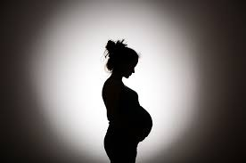
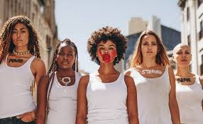
Who is most at risk in our community
Adult females (18-54 years)
Pregnant and postpartum women - The American College of Obstetricians and Gynecologists (also called ACOG) says that 1 in 6 abused women are first abused during pregnancy. More than 320,000 women are abused by their partners during pregnancy each year.

Slide 11
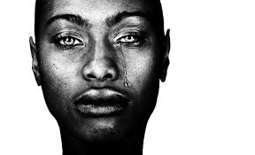
American Indian and Alaska Native Women -1 out of 2 experience physical abuse by an intimate partner. (National Institute of Justice)
African Americans - 45.1% of African American women experience physical violence by an intimate partner in their lifetime. (National Coalitian Against DV)

Slide 12
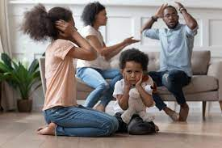
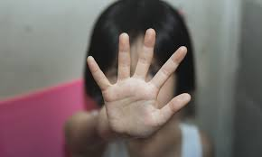
LGBTQ + and gender non-conforming residents - 44% of lesbian women and 61% of bisexual women experienced IPV in their lifetime versus 35% of heterosexual women. 26% of gay men and 37% of bisexual men experienced IPV in their lifetime compared to 29% of heterosexual men. (National Coalition Against DV) Transgender individuals experience even higher rates of IPV as high as 54%.
Residents living in high poverty neighborhoods
Imigrants, both documented & undocumented
Youth and adults who were exposed to DV as children - Children of domestic violence survivors are 3 times more likely to repeat the cycle in adulthood.
https://cdv.org/2014/02/10-startling-domestic-violence-statistics-for-children/

Slide 13
How to Create a Culture of Safety & Support
Provide information on domestic violence
Focus on prevention
Be supportive of victims - believe & provide information
Refer victims to appropriate community agencies
Speak out about domestic violence during sermons.
Learn appropriate ways to respond to abusers & victims

Slide 14
Intervention
The goals of intervention are:
Safety for the survivor, children and faith community
Accountability for the abuser
Restoration of individuals and if possible, relationships, or mourning the loss of relationship
The issue with domestic abuse is safety, not divorce
“Are you safe?”

Slide 15
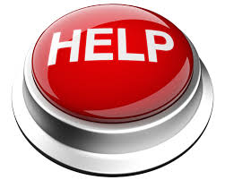
Red Flags and Possible Signs of Abuse for a Victim
Physical warning signs
Bumps
Bruises
Burn marks
Black eyes
Unexplained injuries

Slide 16
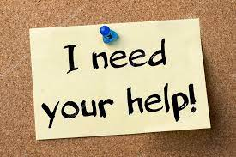
Red Flags and Possible Signs of Abuse for a Victim
Behaviors
Frequently missing work or other appointments
Watching the abusive person for reassurance or approval
Increased isolated from family or friends
Rarely in public without the abusive person with them
Substance abuse or addiction
Depression & anxiety

Slide 17
Red Flags and Possible Signs of Abuse for a Victim
Changes in demeanor
Wearing makeup or sunglasses to cover up bruises or black eyes
Hypervigilant, jumpy, nervous, on edge
Changes in physical appearance - poor hygiene, dirty clothing
Asking you not to say anything
Refusing to answer certain questions about abuse
Cautious when speaking around the abusive person

Slide 18
Red Flags and Possible Behaviors of People Who May be Causing Harm
Aggressive Behaviors
Frequent fighting or arguing
Destruction of property
Verbal, emotional and physical outbursts
Intimidation - anger, hostility and aggression

Slide 19
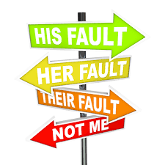
Red Flags and Possible Behaviors of People Who May be Causing Harm
Extremely Defensive
Always right, Inability to receive any feedback
Refuses to apologize
Must be the authority or in charge,
Must have the “Last Word”
Problems with people in authority, history of arrests or incarceration

Slide 20
Support For Safety Planning
DO NOT JUDGE
Let them know they are not alone
Let them know there is HELP and HOPE
DO NOT PRESSURE, even if they are not making a healthy decision - this is their decision (ALWAYS PROTECT CHILDREN)
Encourage the victim to keep records of incidents, photos, documenting time, date, place and any witnesses
Make a safety plan with victim if possible, encourage them to make copies of important documents, passport, ID’s, keys, clothing, medical documents & anything else needed when they leave

Slide 21
Men Creating Peace
Contact information
Men Creating Peace - 360 Grand Ave. #76 Oakland, CA 94610
Call us at: 510-730-0184
Find us at: www.mencreatingpeace.org/contact-us
Social Media
Like us at www.facebook.com/MenCreatingPeace
Follow us at www.instagram.com/MenCreatingPeace
Tweet us @MenCreatePeace (www.twitter.com/mencreatepeace)

Slide 22
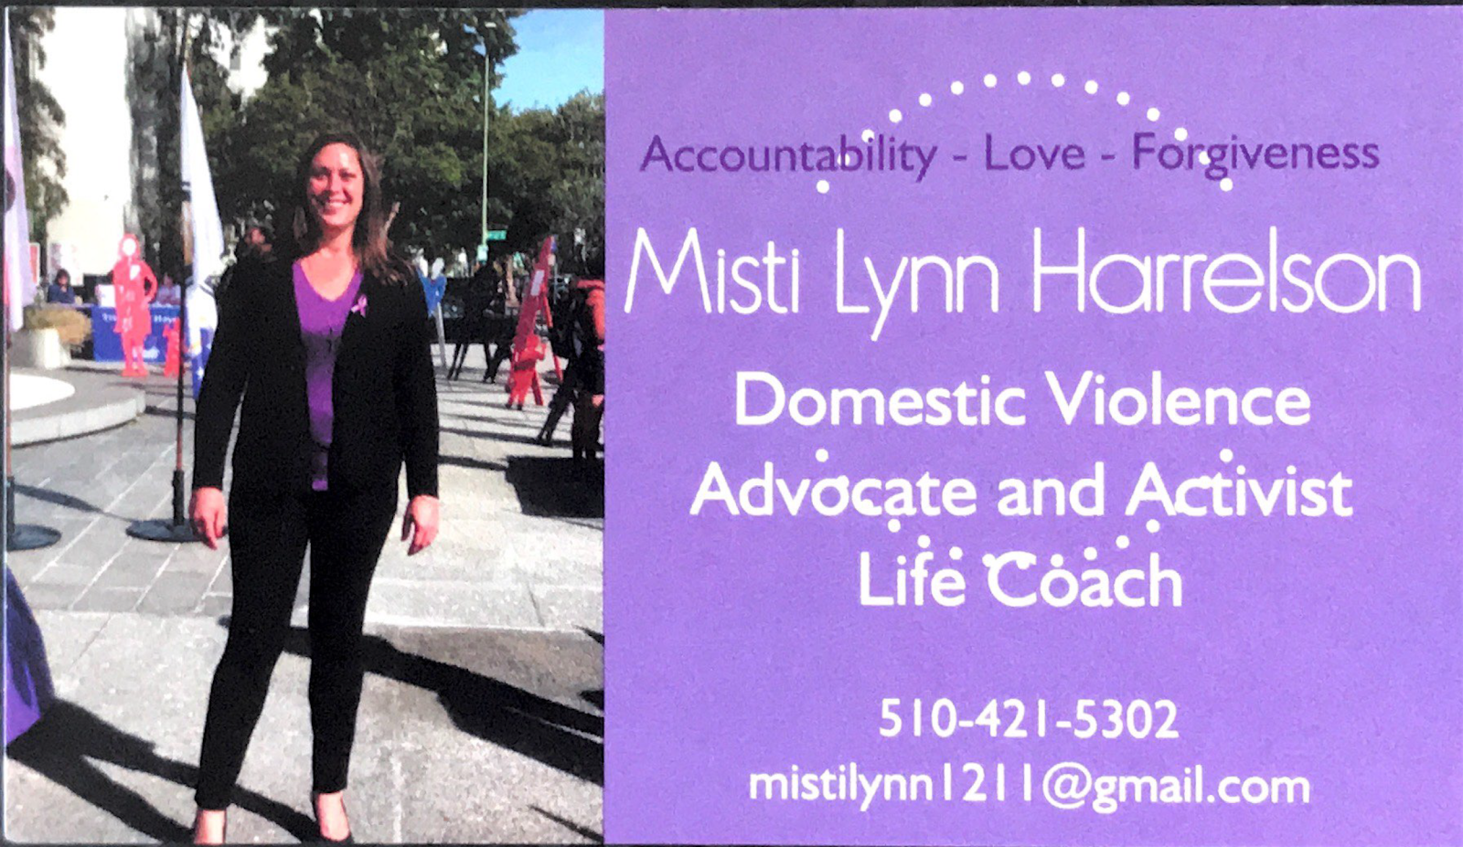

Slide 23
Will Yancy M.A.Ed.
Triumph Educational Center
16105 Mateo Street
San Leandro, CA, 94578
510 504-0648
willyancy@triumphtogether.org
www.triumphtogether.org

Slide 24
Suggestion Resources for Faith Leaders
Domestic Violence and Faith Communities https://www.ny.gov/sites/default/files/atoms/files/Domestic_Violence_Guidebook_for_Faith_Leaders.pdf
Https://vawnet.org/sc/domestic-violence-and-religion
Religion & domestic violence: books, web sites http://www.ncdsv.org/images/Religiondomesticviolencebooks.pdf Agencies and Organizations
CONNECT Faith: http://www.connectnyc.org/program/connect- faith
Safe Havens Interfaith Partnership Against Domestic Violence
http://www. interfaithpartners.org/

Slide 25
National DV Resources
National Family Justice Center (FJC) – Alliance for Hope –
https://www.familyjusticecenter.org/
National Domestic Violence Hotline – provides access to local DV resources for both victim and person who causes harm
https://www.thehotline.org/ 1-800-799-7233
https://victims.ca.gov/board/trauma-recovery-centers/
National Resource Center on Domestic Violence – resource and national community based organization networks
https://www.nrcdv.org/

Slide 26
California DV Resources
California Partnership to End Domestic Violence
https://www.cpedv.org/domestic-violence-organizations-california
Phone number 916-444-7163
This is a complete guide to DV Resources for the entire State of California

Slide 27
Alameda County DV Resources
Crisis Resources for Alameda County
https://drive.google.com/file/d/1PwKYlePhPwscm7J6FHB-clOJsNtJ5iO5/view
Domestic Violence Resource Guide for Alameda County
https://drive.google.com/file/d/1OFh2X8UPxf0mBHk2VcUmPiqUIfmiMX3D/view
Batterer’s Intervention Programs in Alameda County
https://www.acgov.org/probation/documents/DVPROVIDERSLIST.pdf
CRISIS SUPPORT SERVICES - 24 HOUR CRISIS LINE:
1-800-309-2131

Slide 28
Marin County DV Resources
https://centerfordomesticpeace.org/
24 hour DV crisis line 415.924.6616
Therapy and support groups: 415-526-2553
ManKind Program 415.457.6760 - Men’s violence prevention
Marin Youth Services Text Line 415.526.2557
Community Violence Solutions https://cvsolutions.org/
1-800-670-7273

Slide 29
Contra Costs DV Resources
Stand For Families Free of Violence
https://www.standffov.org/resources-and-information/
24/7 Crisis and Support line: 888-215-5555
Children’s Counseling Program: 925-222-2132
Contra Costa County Mental Health Services: 888-678-7277
Rainbow Community Center’s Clinical Services: 925-692-2056
Men’s Violence Prevention Group: 925-676-2968
Contra Costa Family Justice Center: 925-521-6366 (Central),
510-974-7200 (West)

Slide 30
San Francisco County DV Resources
https://sf.gov/information/domestic-and-family-violence-resources
http://www.womaninc.org/ 24-Hour Crisis Line: 415-864-4722
Family & Children Services Hotline tel:800-856-5553
La Casa De Las Madres 24-Hour Adult Crisis Line: 877-503-1850
Asian Women's Shelter 24-Hour Crisis Line at 877-751-0880
LGBTQ Services Community United Against Violence - (415) 777-5500
SFSD Survivor Restoration Program (415) 734-2312
List of Batterer’s Programs https://sf.gov/information/batterers-intervention-program-bip-provider-2022

Slide 31
San Mateo County DV Resources
CORA https://www.corasupport.org/ Resources@CORAsupport.org
24-Hour Hotline: 800.300.1080 Legal Information Line:
650-259-1855; 650-312-8515
Domestic Violence Collaborative: (650) 558-0915.
Bay Area Legal Aid (800) 551-5554 www.baylegal.org
https://sanmateo.networkofcare.org/aging/library/article.aspx?hwid=te7721
List of Batterer Treatment Programs in San Mateo County
https://www.smcgov.org/media/145944/download?attachment

Slide 32
Questions and Answers

